Slide 1

Cloud Computing Project Project-TECH TALK
Submitted by: Akarsh Singh
Shivani Chauhan
Vanshika Mahle
Vimal Mishra
GLA University
Mathura-281406,INDIA
2021

Slide 2
Introduction
Tech Talk is a full-stack Real Time Chat Application from front end to back end to be developed using Android Studio and Google Firebase.
The clients can send and receive messages, images or videos instantly with the help of real-time firebase database and storage.
The users need to authenticate themselves before accessing the application using Firebase Authentication services.
The application will show push notifications upon receiving any new message or friend request from another user in the chat.
User can send direct messages or share files to another user only after accepting his/her friend request.
Profile information or passwords can be updated using the Account section of the user.
In order to connect with people, client should have internet facility.

Slide 3
Purpose
The purpose, the scope, the users and stakeholders, the use cases, the functional and non-functional requirements, and the milestones of the application. The purpose of the chat application is to allow users be able to the chat with each other, like a normal chat application.
The users will be able to chat with each other, most likely only from user to user, no group chatting will be developed, unless there is time to do so.
Providing users with rich features, these apps deliver incredible live chat experience, allowing users to share text messages, images, emoticons, stickers, audio and video clips and other media content.

Slide 4
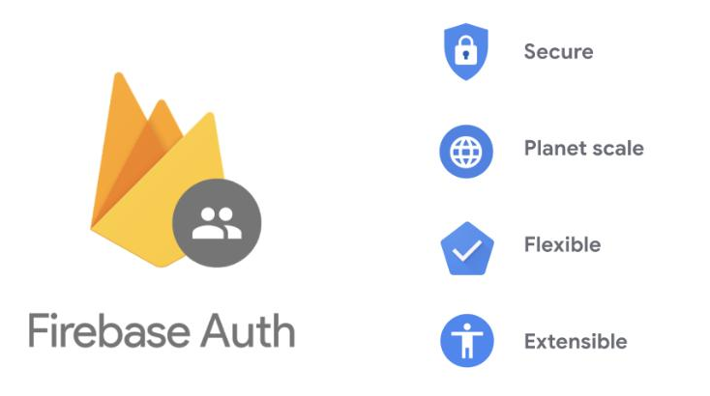
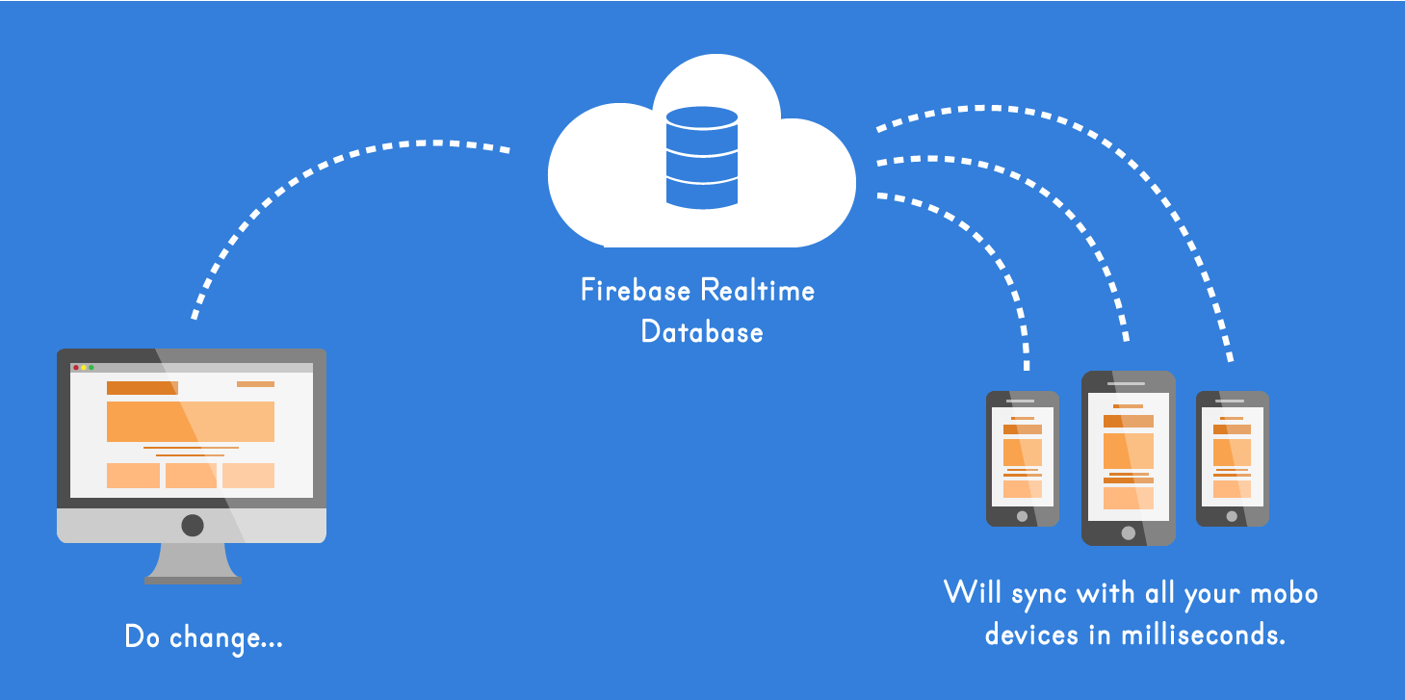
Why Firebase
Firebase Auth
Realtime Database
Firebase Storage

Slide 5
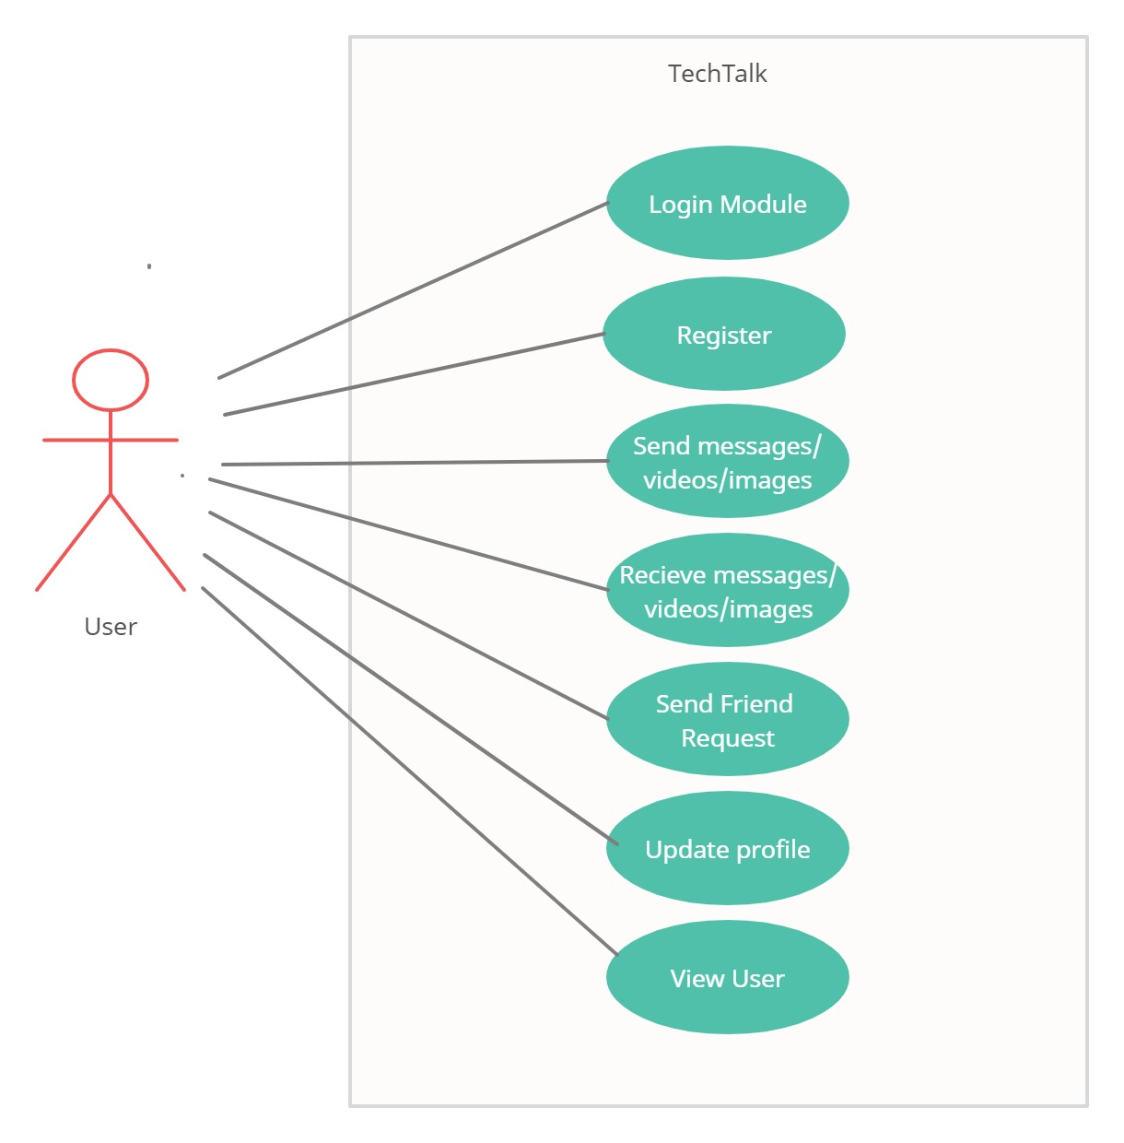
USE Case

Slide 6
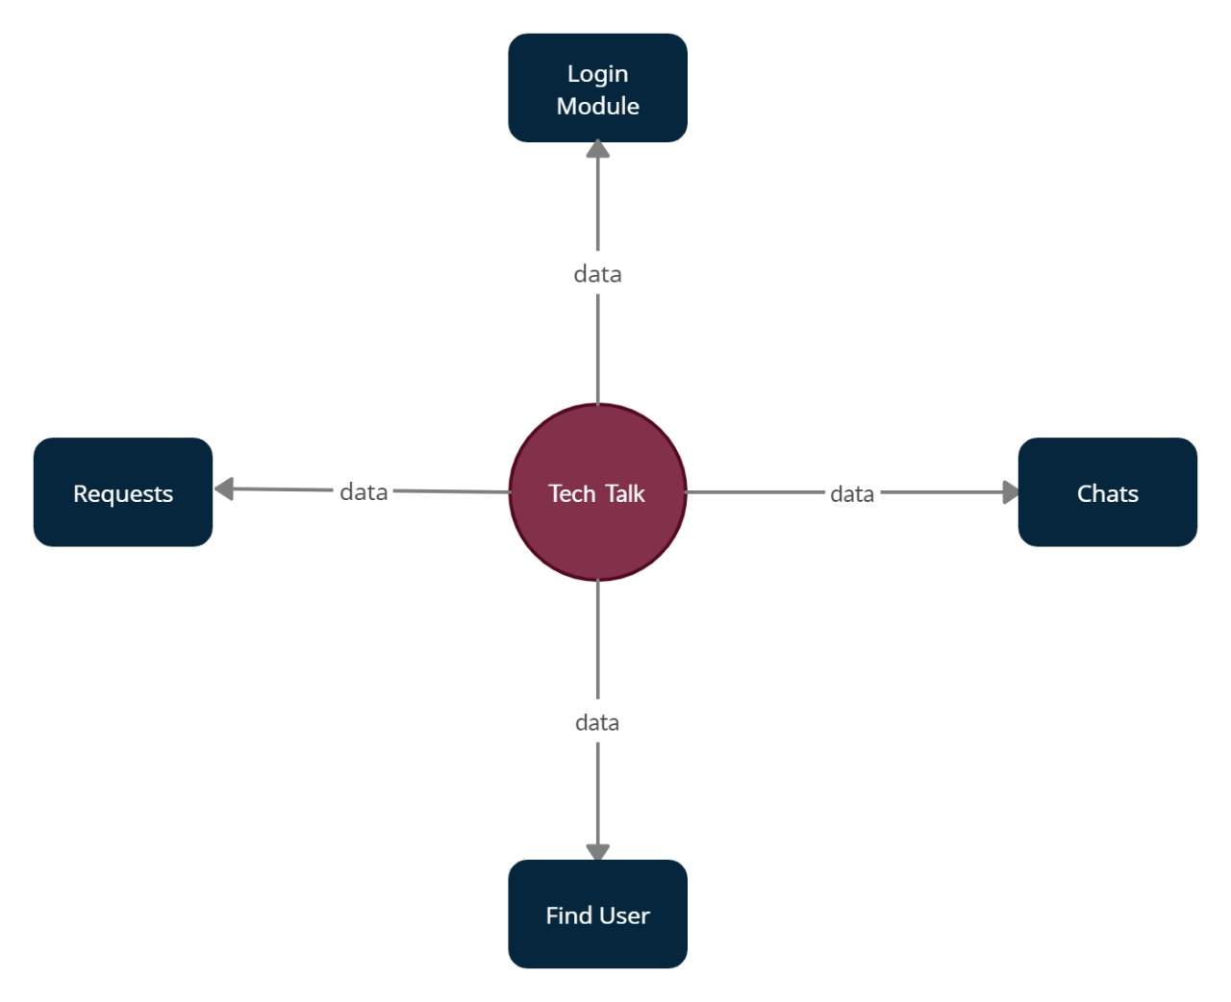
DFD

Slide 7
CHAT APP ACTIVITIES

Slide 8
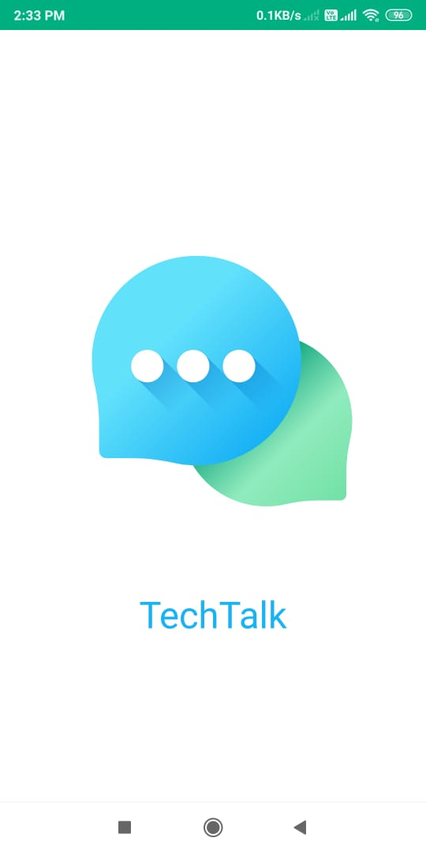
Splash Activity

Slide 9
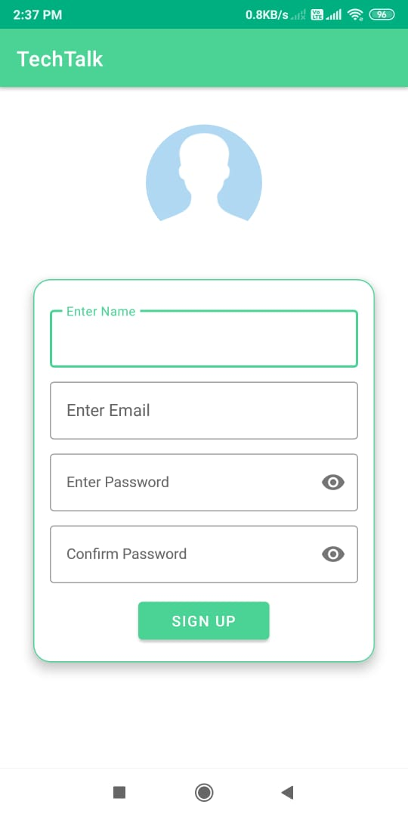
Sign-Up Activity
Only unique user are allowed
On registration Firebase AUTH generates a unique ID which we store in our database along with username.
Password is securely stored inside the Firebase AUTH for more security and hence not included in our Real-time database.

Slide 10
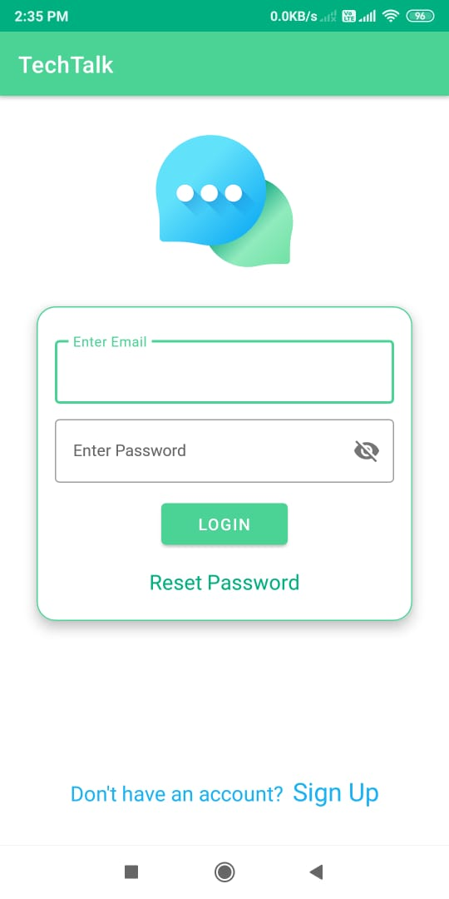
Login Activity
First Screen when the app is opened
Email and passwords goes to Firebase Auth for automatic authentication

Slide 11
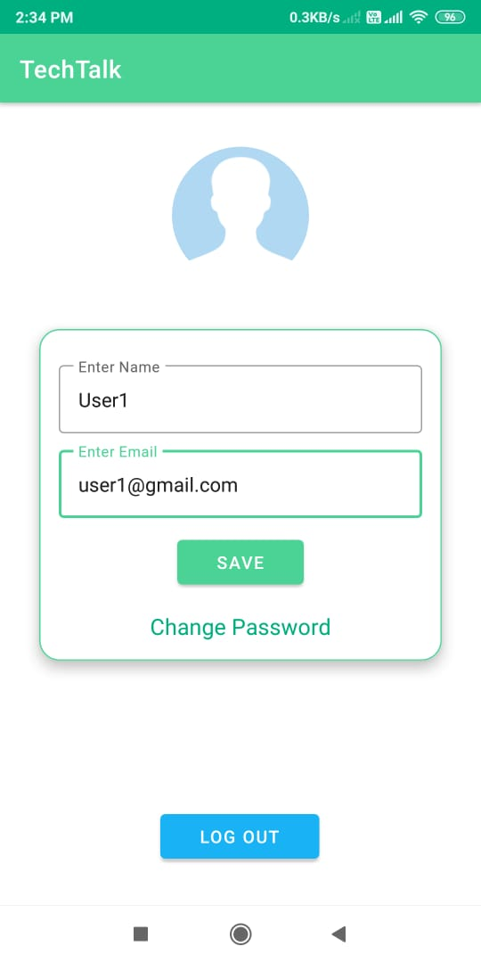
Profile Activity
In this Activity user can change his/her account details. Ex: Email, Username and profile image.

Slide 12
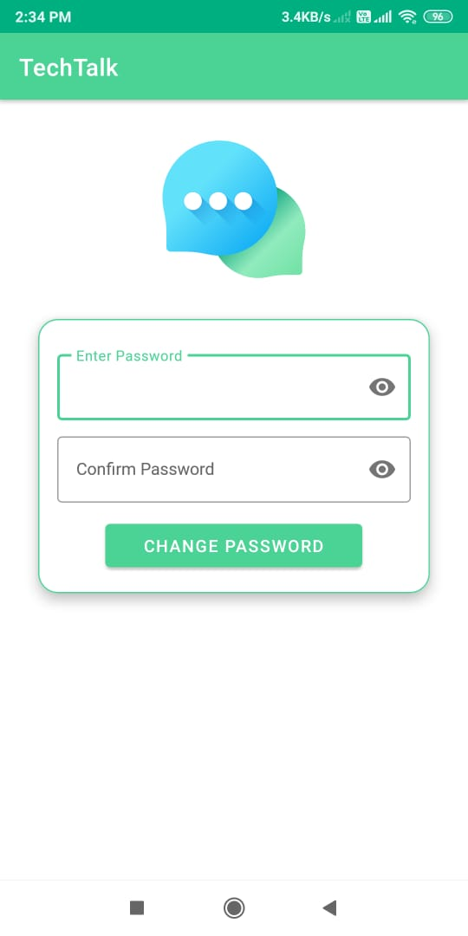
Change Password
In this Activity user can change his/her password.

Slide 13
Reset Password
In this Activity user can reset his/her password.
New Password will be saved in Firebase Auth accordingly

Slide 14
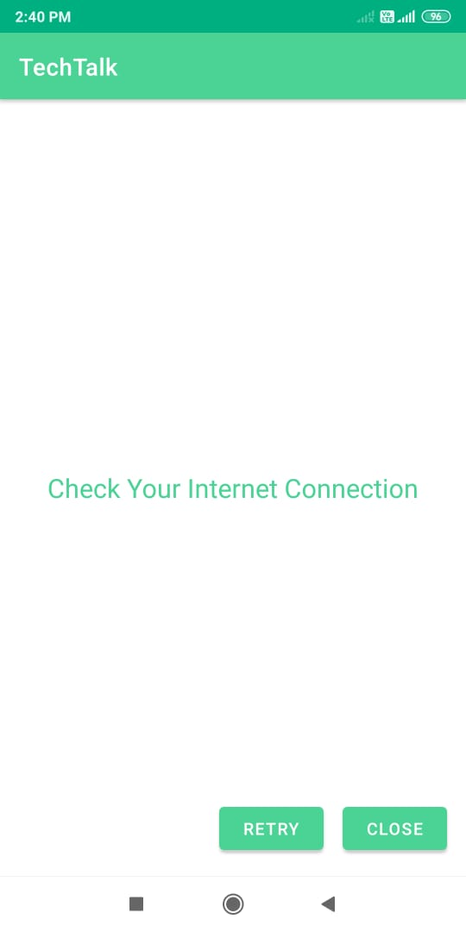
Message Activity
In this user can send one to one messages.
And, if user is not online it will display an error message.

Slide 15
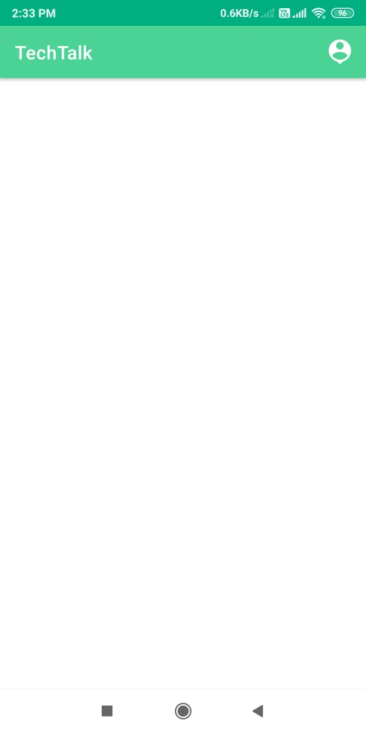
Main Activity
In this Activity user will be able to chat with one other, find friends, accept/reject friend requests

Slide 16
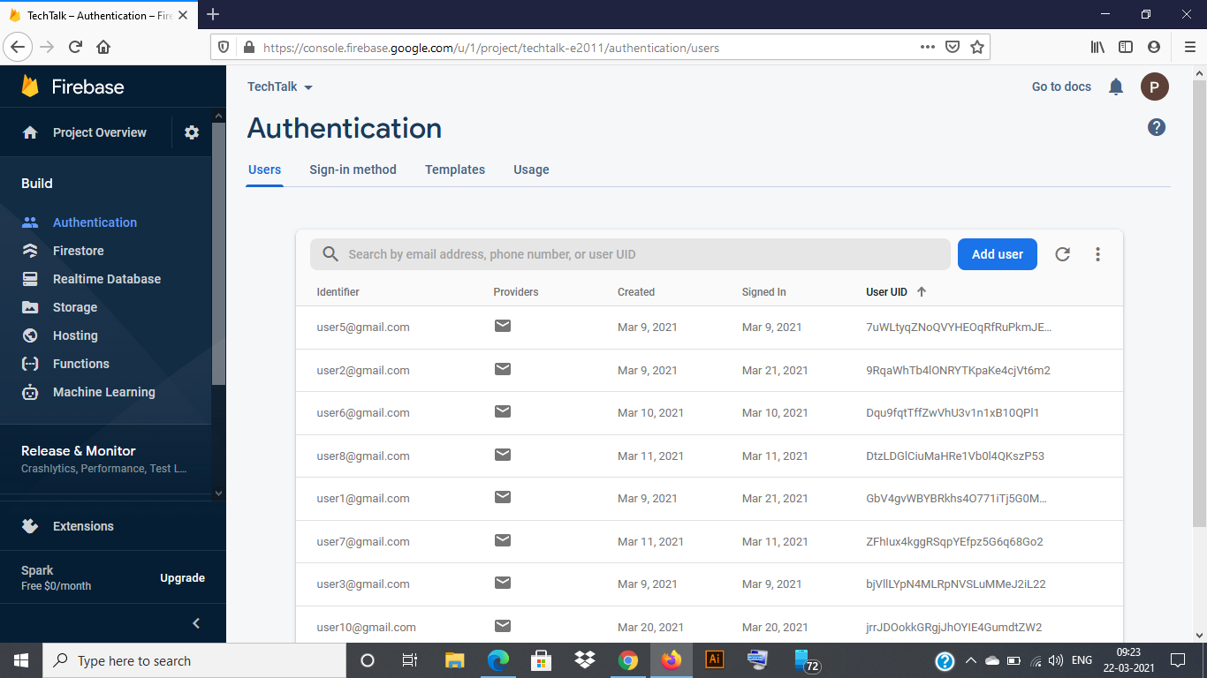
Firebase Auth

Slide 17
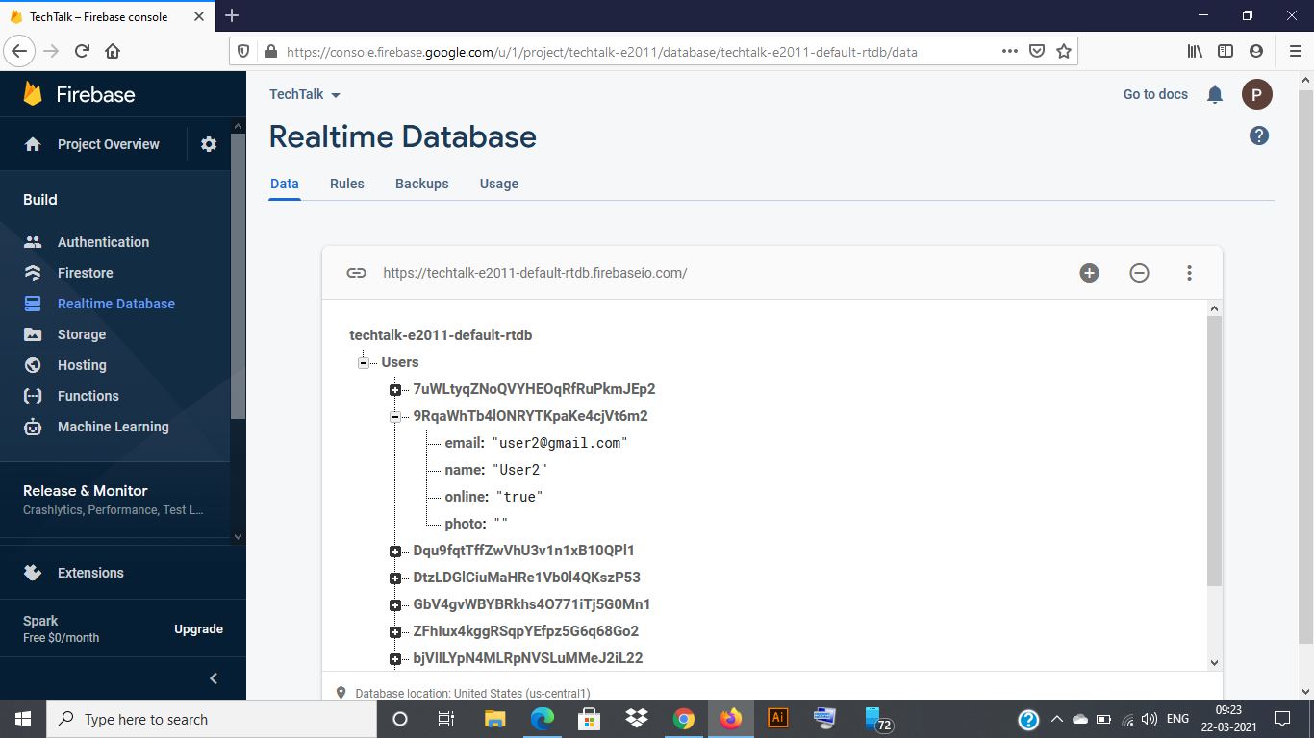
Firebase Realtime Database Snapshot

Slide 18
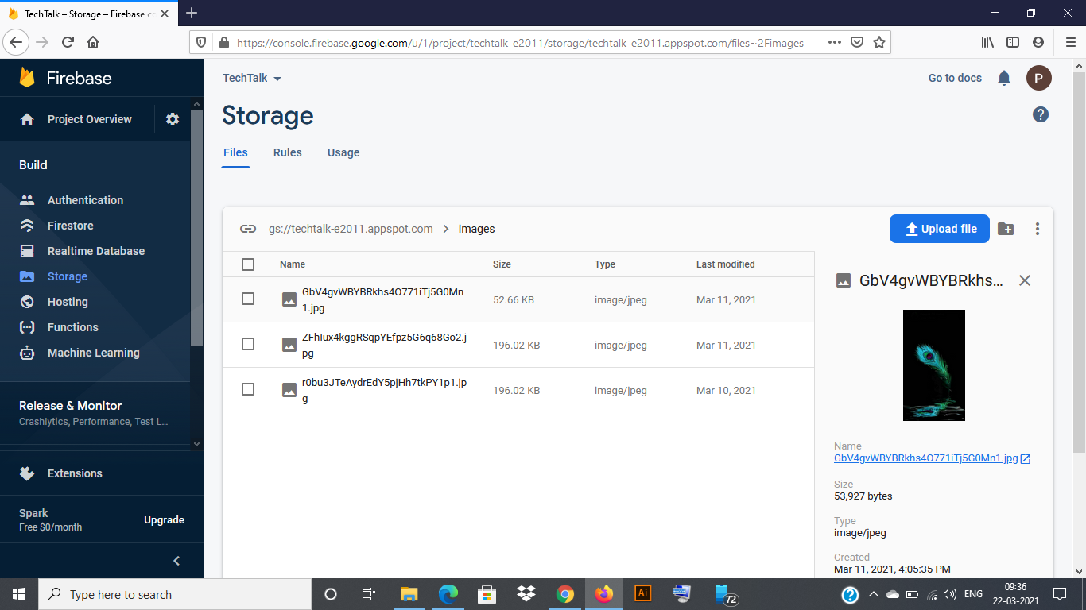
Firebase Storage

Slide 19
References
Create a complete, full-stack chat application from front end to back end using Android Studio and Firebase- Udemy.com

Slide 20
THANK YOU.

